Slide 1
AI-Powered Form Filling Assistant
For Indian Citizen Services
Presented by :
Himel Dutta
Sayan Bhattacharjee

Slide 2

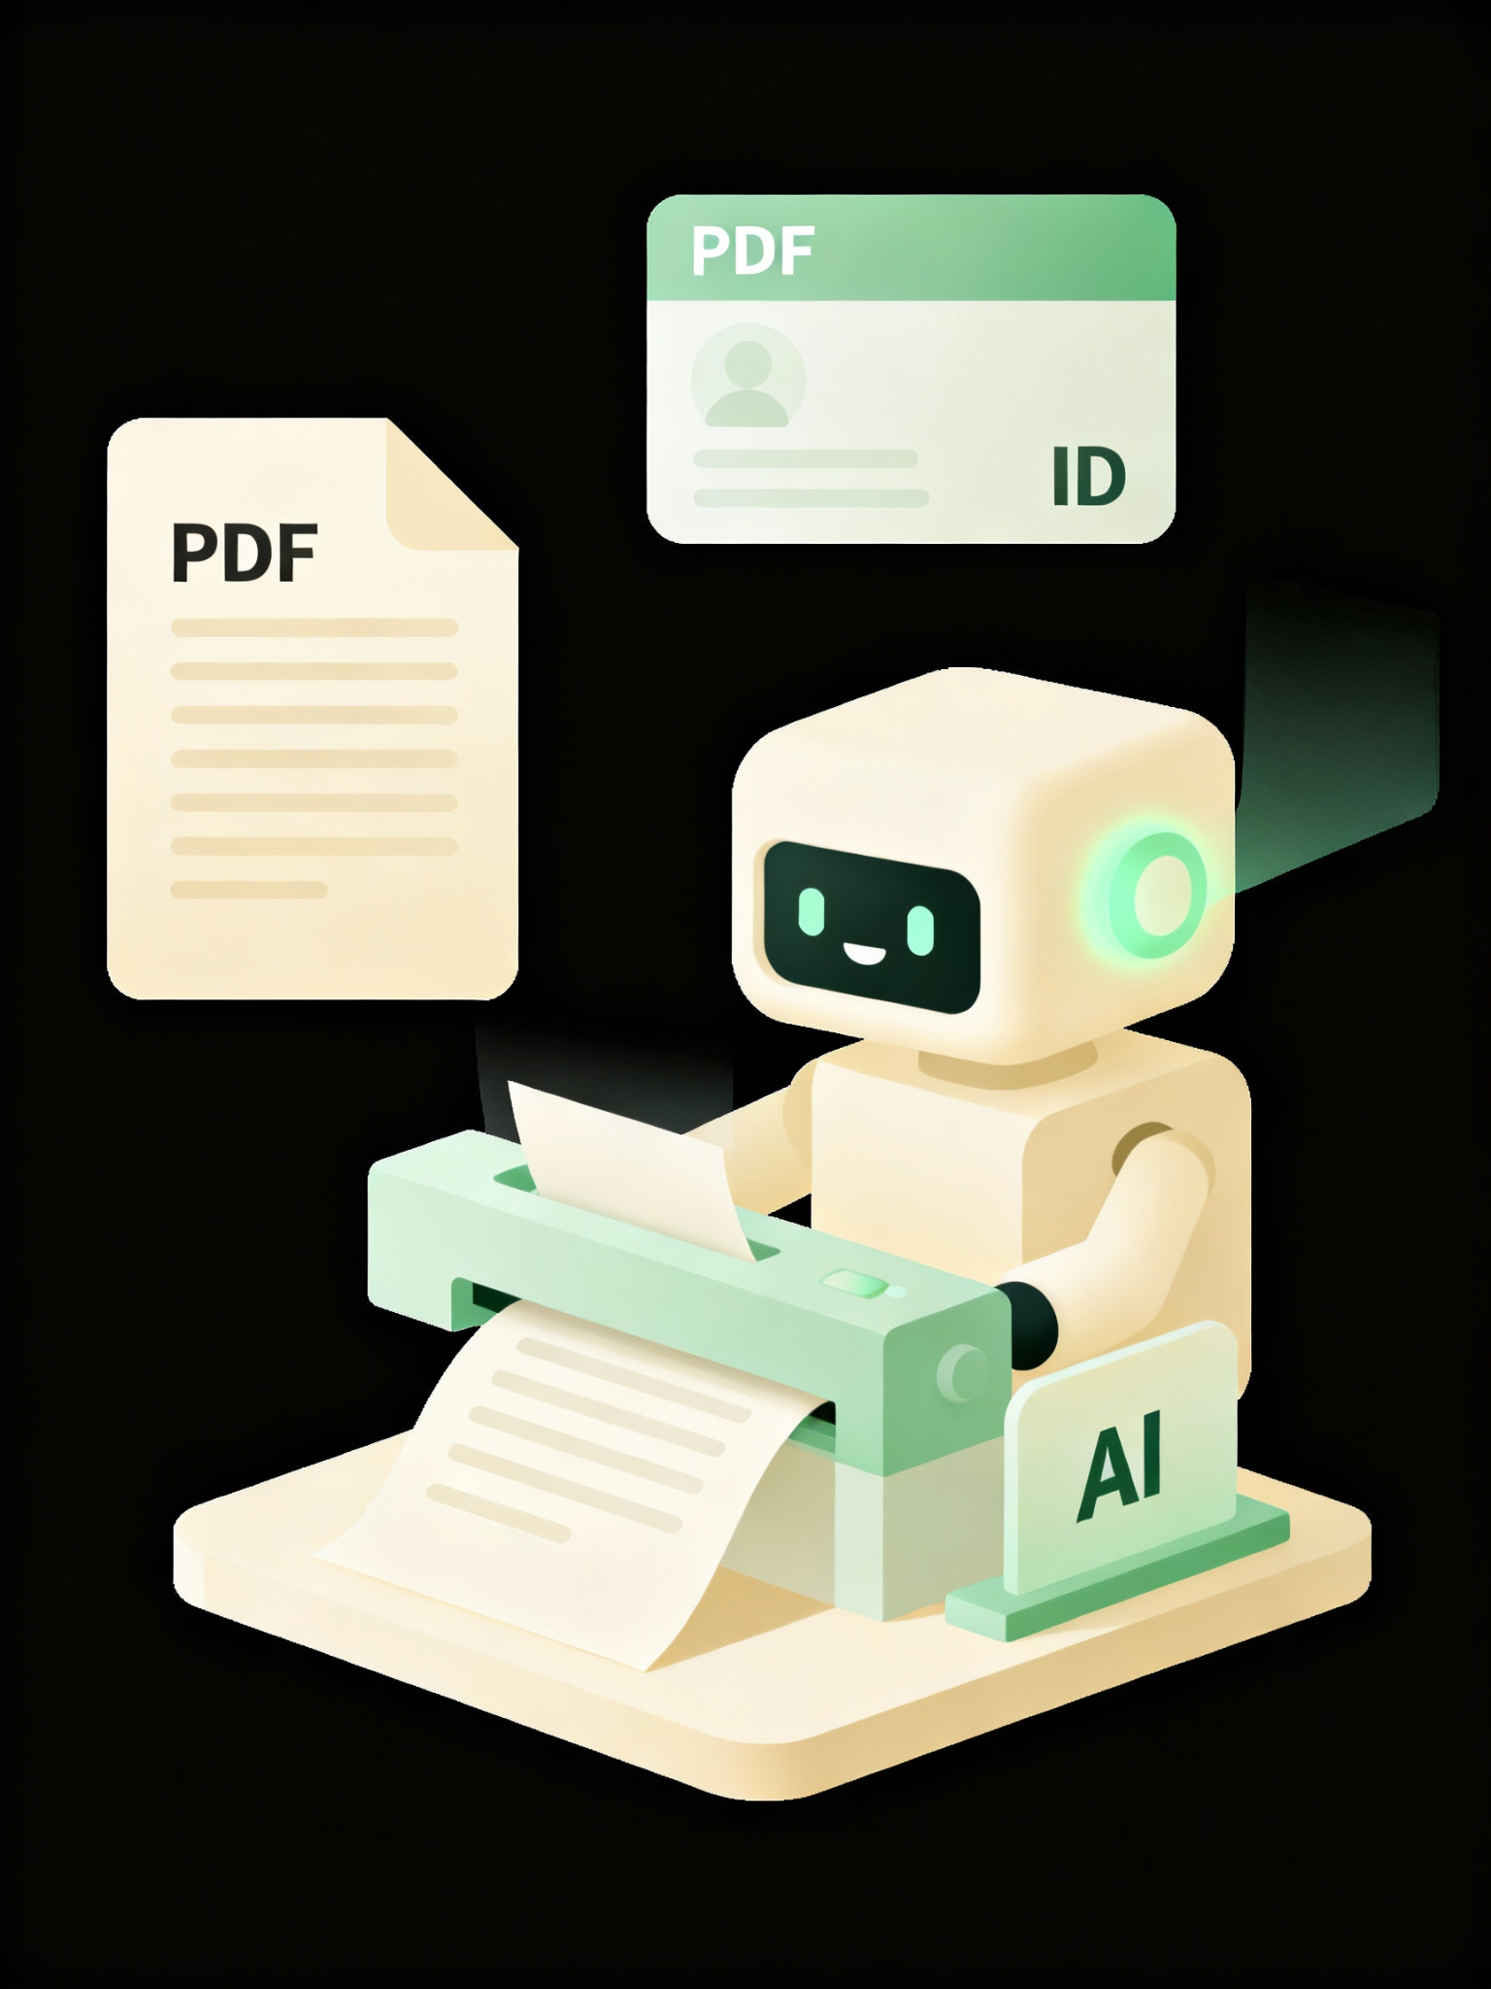
INTRODUCTION
Millions of Indians visit Seva Kendras daily for certificates, licenses, and government schemes — but most of their time goes into repeatedly filling forms with the same Aadhaar, PAN, or voter ID details.
Our solution: An AI-Powered Form Filling Assistant that reads uploaded documents, extracts key information, and auto-fills government forms in seconds. Users can quickly review, edit, and download the completed form.
This makes public services faster, more accurate, and far more accessible.

Slide 3
PROBLEM STATEMENT
AI-Powered Form Filling Assistant for Indian Citizen Services
Citizens often need to fill in multiple government service forms at Seva Kendras (e.g., for certificates, licenses, and welfare schemes). This project aims to build an AI tool that auto-fills these forms based on uploaded documents (Aadhaar, PAN, voter ID, etc.), reducing manual effort and errors.
Core Features:
• Upload documents (PDF/images) → Extract key details (name, DOB, address, ID numbers).
• Auto-map extracted data to the correct fields in government form templates.
• Allow user review and edit before submission.
• Support multiple Indian languages.
• Voice based input to fill the details

Slide 4
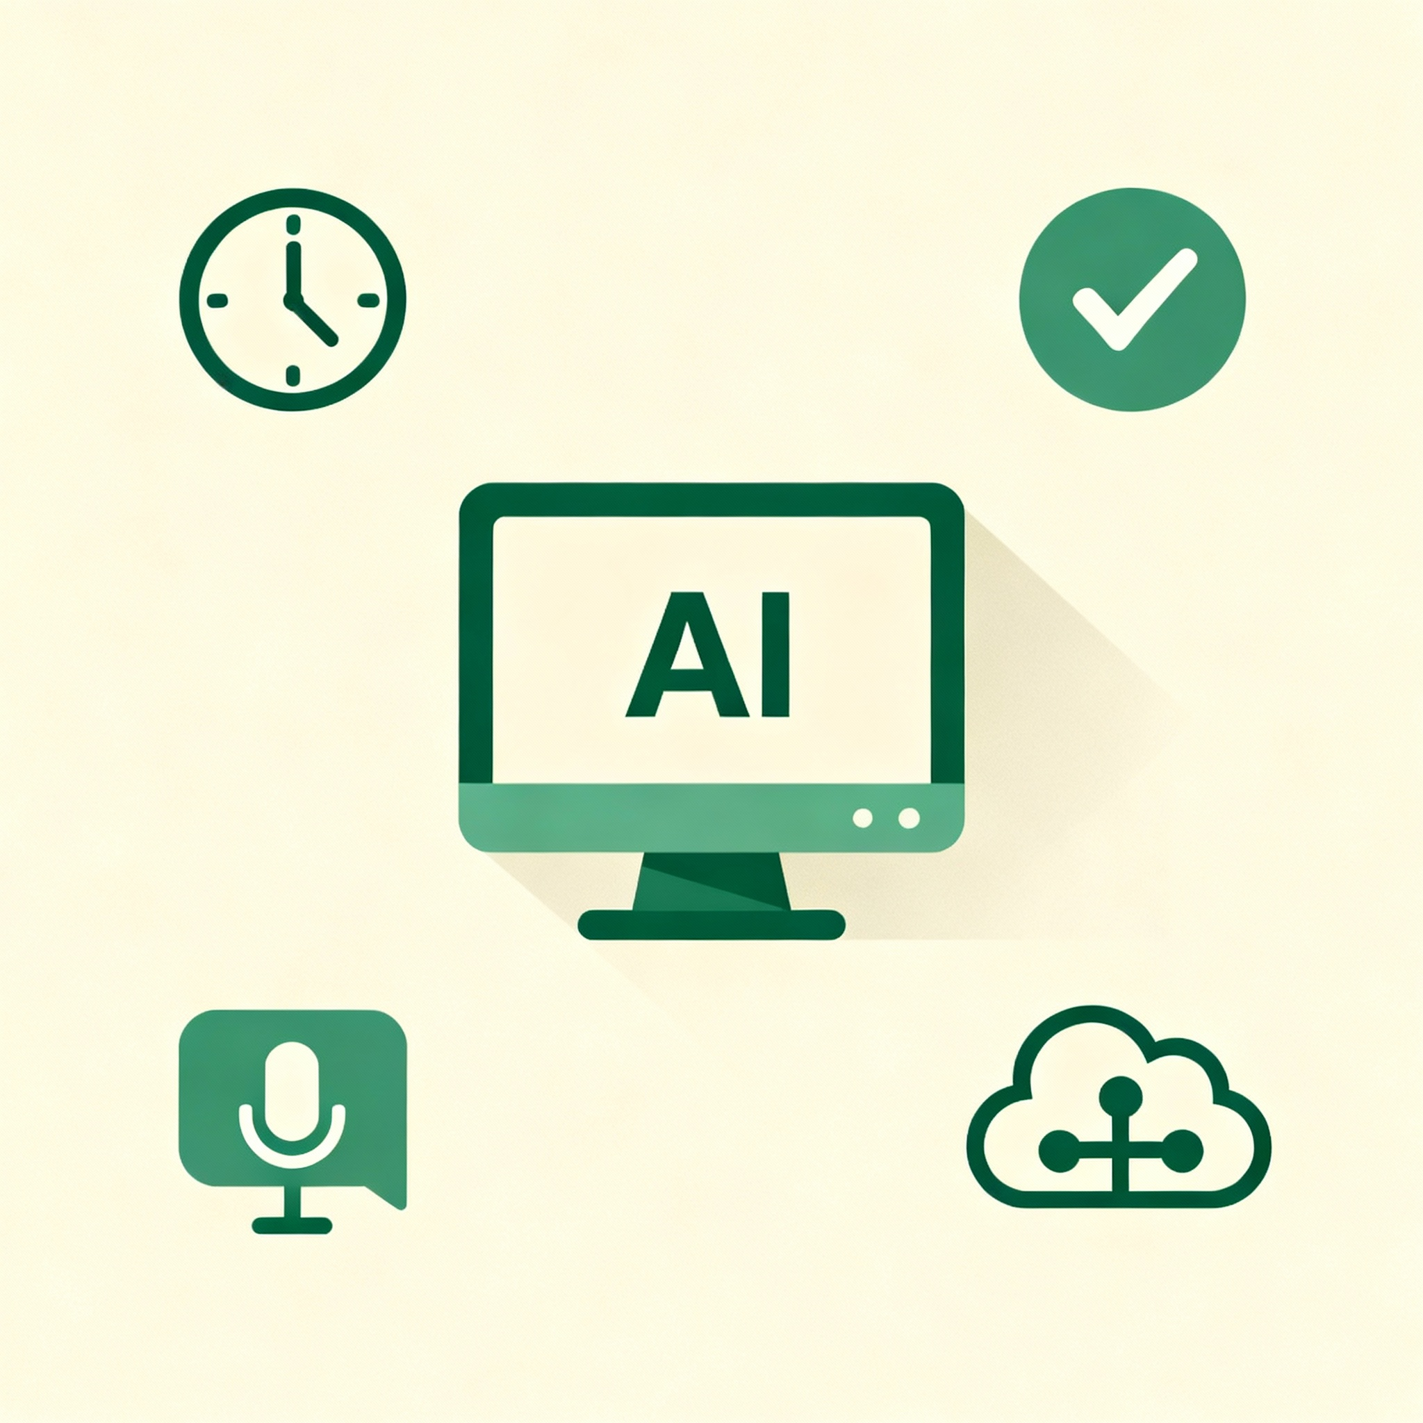
OBJECTIVES
The project aims to build an AI assistant that extracts key details from uploaded documents and automatically fills government forms using OCR, entity extraction, and smart field mapping.
Key objectives:
High accuracy and fast processing
Support for multiple Indian languages and voice input
Simple interface for review, editing, and download
Scalable design with future support for handwritten text and DigiLocker integration

Slide 5





APPLICATIONS
Seva Kendras & Government Offices: Automates form filling for certificates, licenses, and schemes, reducing queues and manual effort.
Citizen Service Portals: Integrates into online platforms to auto-fill forms from uploaded documents.
Banks & Financial Services: Simplifies KYC by auto-extracting Aadhaar/PAN details.
Healthcare & Insurance: Speeds up patient registration and policy form submissions.
Educational Institutions: Auto-fills admission and scholarship forms.

Slide 6
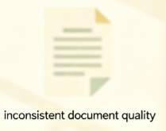
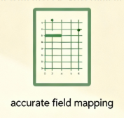


CHALLENGES
Inconsistent Document Quality: Blurry scans, low-resolution images, and varying formats make OCR extraction difficult.
Accurate Field Mapping: Aligning extracted data with diverse government form templates requires robust logic and model tuning.
Multilingual Complexity: Handling names and addresses across many Indian languages increases NLP difficulty.
Scalability & Integration: Preparing the system to support handwritten text, more form types, and future integrations like DigiLocker.

Slide 7


DEVELOPMENT TOOLS USED
Programming & Frameworks: Python, ReactJS for front-end, NodeJS for backend integration.
OCR & ML Frameworks: Tesseract OCR, Intel-optimized libraries like Pandas, NumPy, SciPy, Scikit-Learn, XGBoost.
Performance Optimization: Intel hardware optimizations for faster inference and reduced latency.
Version Control & Collaboration: Git and GitHub for source code management.

Slide 8
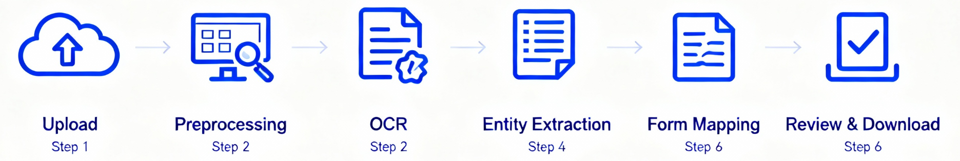
WORKFLOW
Document / Voice Ingestion - Users upload PDFs/images or provide voice input. Voice is converted to text using speech-to-text processing.
Pre-Processing - Images undergo noise removal, resizing, binarization, and orientation correction to improve OCR accuracy.
OCR Extraction - Tesseract (with Intel optimizations) extracts raw text from Aadhaar, PAN, voter ID, and other documents.
Entity Extraction - ML/NLP models identify key fields such as name, DOB, gender, ID numbers, and other structured details.
Field Mapping Engine - Extracted entities are mapped to the correct fields of government form templates using rule-based + ML-based logic.
User Review Layer - A web interface displays the auto-filled form, allowing users to edit or correct details before finalizing.
Form Generation - The system generates the completed form in downloadable format (PDF/print-ready), ready for submission.

Slide 9
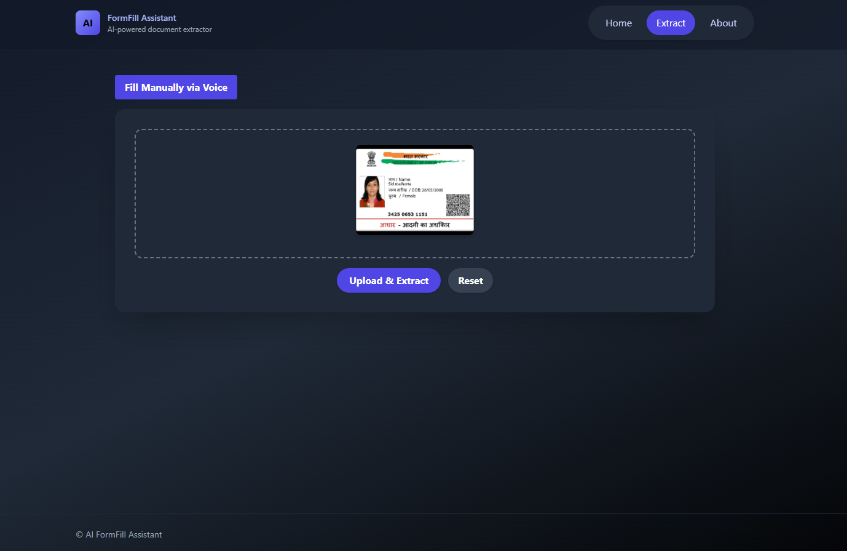
UPLOAD INTERFACE

Slide 10
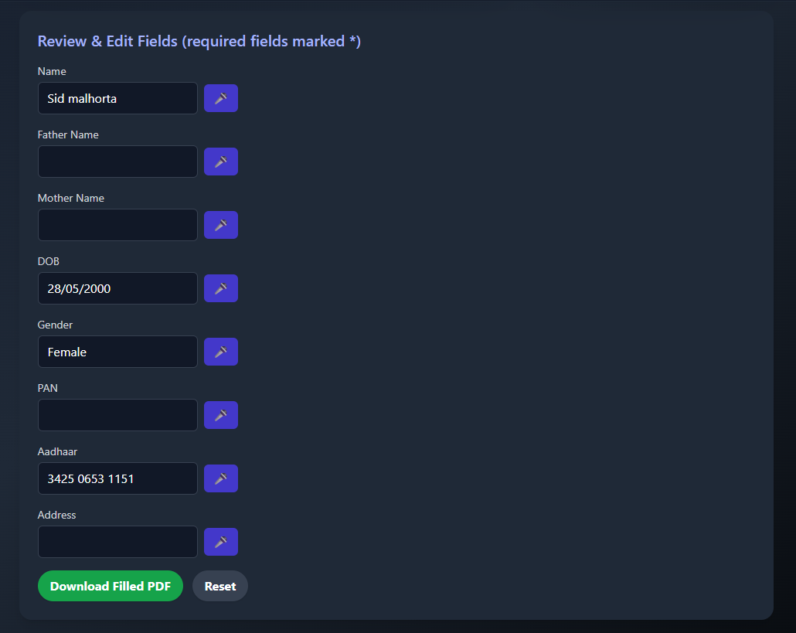
AUTO-FILLED EDITABLE FORM INTERFACE

Slide 11
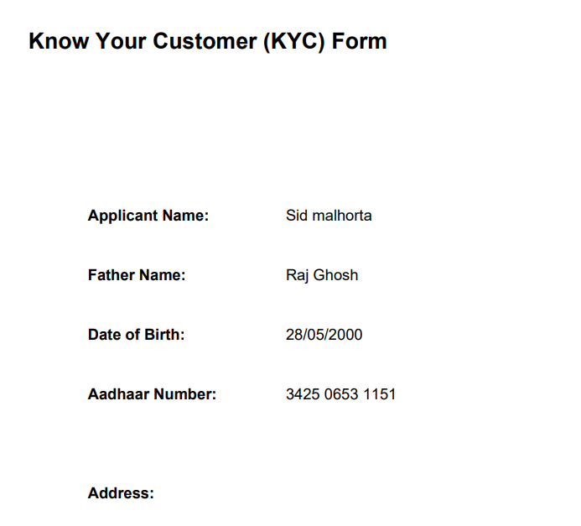
FINAL FILLED FORM

Slide 12
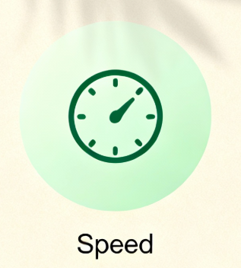
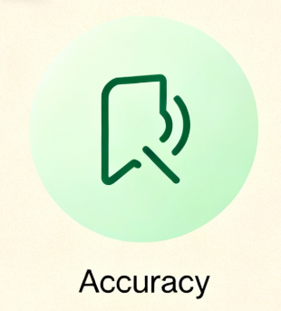

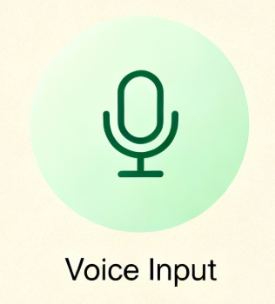
RESULT & OUTPUT
The system successfully extracts key information from documents like Aadhaar, PAN, and voter ID with high accuracy.
Auto-filling of government form templates is completed within 3–5 seconds, meeting the performance target.
Users can preview the filled form, make edits, and download the final output as a PDF or print-ready file.
Multilingual text extraction and voice-based input work reliably, improving accessibility for a wide range of users.

Slide 13
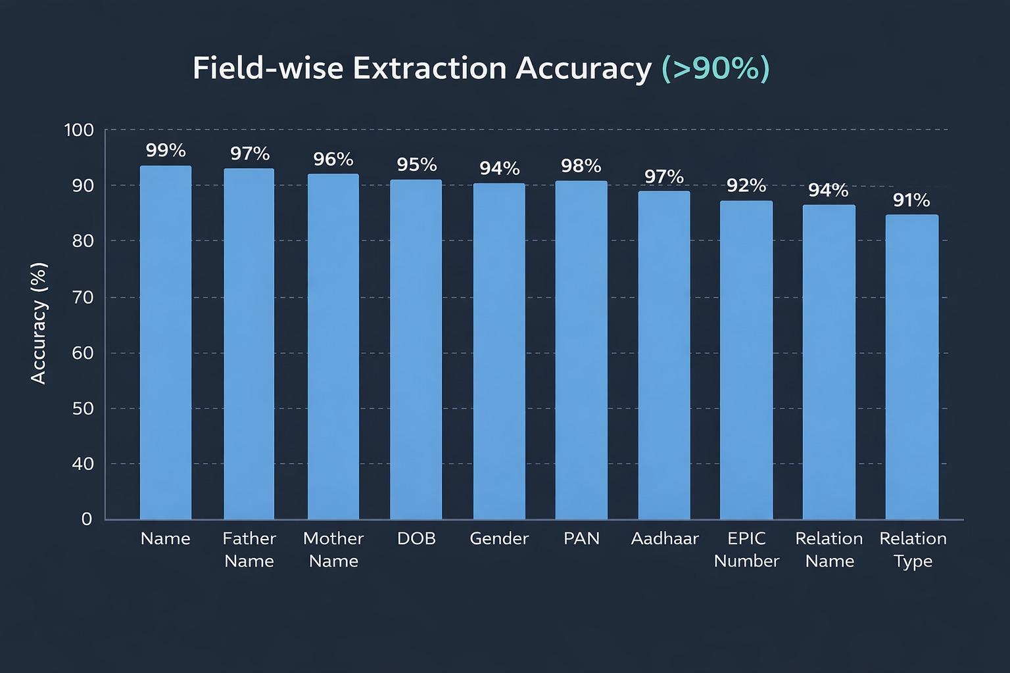
ACCURACY

Slide 14
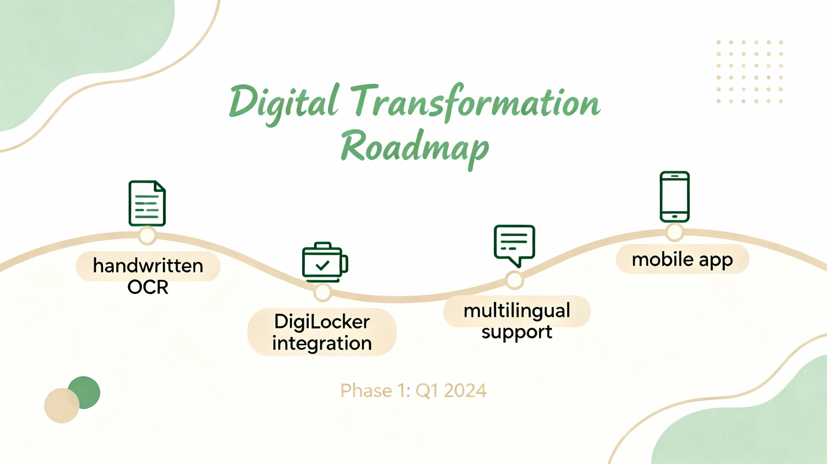
FUTURE SCOPE
Handwritten Text Recognition: Extend OCR capabilities to accurately process handwritten government documents and forms.
DigiLocker Integration: Allow users to directly import verified documents from DigiLocker for faster and more secure form filling.
Support for More Form Types: Expand the system to cover additional certificates, licenses, and department-specific applications.
Indian Language Expansion: Improve multilingual NLP models to handle more regional languages with better accuracy.
Mobile App Development: Build an Android/iOS app for on-the-go document scanning and instant form auto-fill.

Slide 15
CONCLUSION
The AI-Powered Form Filling Assistant significantly simplifies the process of completing government service forms by automatically extracting and mapping information from citizen documents. Through OCR, ML-based entity extraction, and an efficient form-mapping pipeline, the system reduces manual effort, minimizes errors, and improves accessibility. With multilingual and voice support, optimized performance, and a user-friendly interface, the project demonstrates how AI can modernize public services and enhance the overall citizen experience.

Slide 16
ACKNOWLEDGEMENT
We would like to express my heartfelt gratitude to all those who contributed to the successful completion of this project. We are deeply thankful to our faculty and mentors for their continuous guidance, insightful suggestions, and encouragement at every stage of development. Their expertise helped shape the direction and quality of this work.
We also acknowledge the supportive learning environment, access to tools, and technical resources that enabled us to explore and implement advanced AI concepts effectively. Lastly, we are grateful to everyone who provided feedback, motivation, and assistance throughout this journey. Their support has been invaluable in bringing this project to life.

Slide 17
THANK YOU

